Slide 1
Pattern matching algorithms

Slide 2
Naive string matching algorithm
Pattern matching problem actually decides whether a Given string pattern appears in a Text string or not.
In the NIEVE approach we match the pattern with the string at every position
Here , LENGTH of the PATTERN must be <= Given string
Now lets have a look at the pseudo code of NAÏVE STRING MATCHING ALGORITHM:
Lets consider the function int match(T,P)
Step 1 : n = length of T

Slide 3
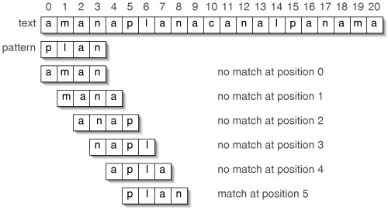
Step 2 : m = length of P
Step 3 : for s=0 to n-m
Step 4 : if p[0,...m-1] = T[s+0,...s+m-1]
Step 5 : print “pattern matched”
Step 6 : if step 4 is false then print “not found”
Step 7 : END
Now look at the example below:
NB : say, a = TEXT string and b = given string (to be searched)

Slide 4
int match(char *a, char *b){
int position = 0;
char *x, *y;
x = a;
y = b;
while(*a) {
while(*x==*y) {
x++; y++;
if(*x=='\0'||*y=='\0') break;
}
if(*y=='\0')break;
a++;
position++;
x = a; y = b;
} if(*a)
return position;
else return -1;
}

Slide 5
Rabin-Karp algorithm
In this case in order to avoid the comparison between the pattern and the text character by character, we’ll try to compare them at once, so we need a good hash function. With its help we can hash the pattern and check against hashed sub-strings of the text. We must be sure that the hash function is returning “small” hash codes for larger sub-strings. Another problem is that for larger patterns we can’t expect to have short hashes. But besides this the approach should be quite effective compared to the brute force string matching or NAÏVE’s ALGORITHM.
That approach is known as Rabin-Karp algorithm.

Slide 6
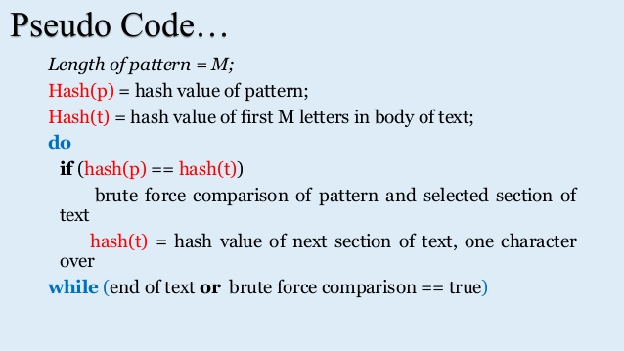

Slide 7
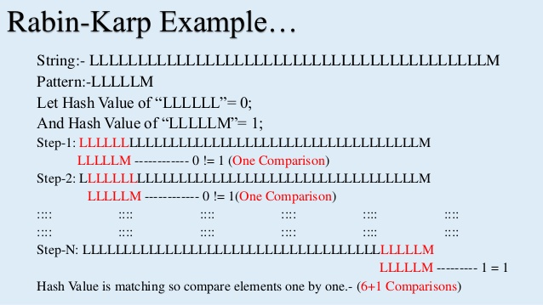

Slide 8
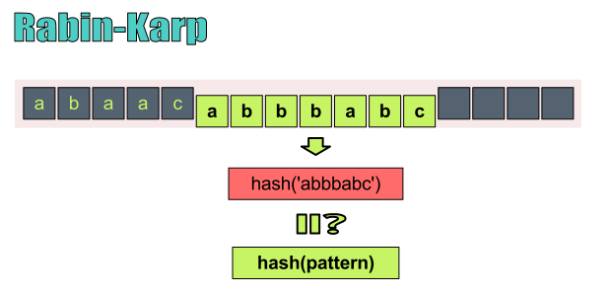
Rabin-Karp hashes the pattern and the sub-string in order to compare them quickly!

Slide 9
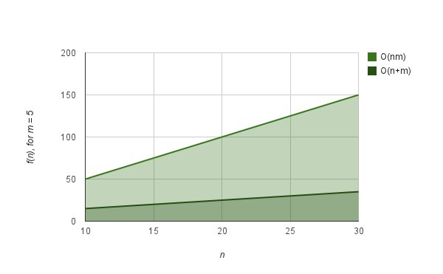
COMPLEXITY

Slide 10
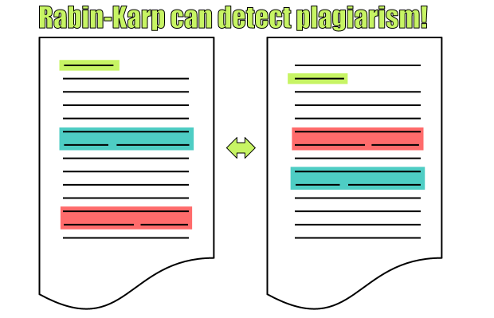

Slide 11


